Slide 1
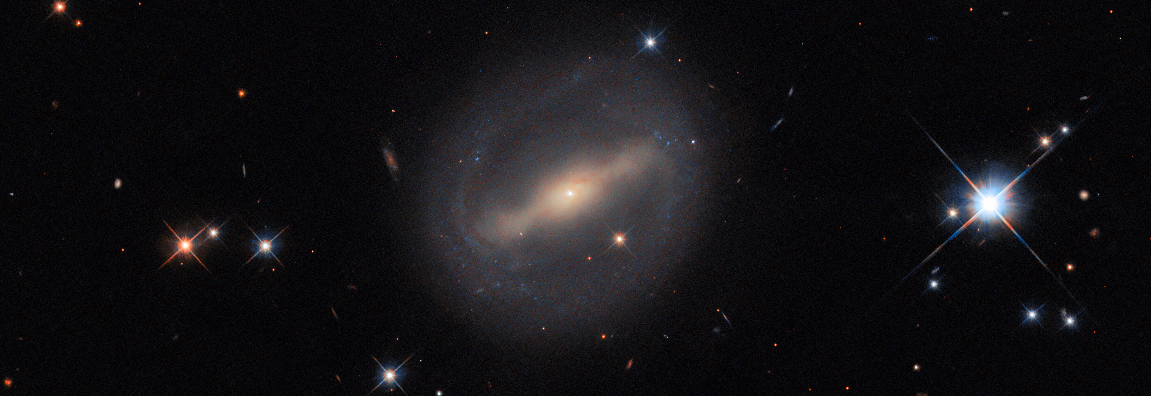

CONVOLUTIONAL NEURAL NETWORKS FOR GALAXY MORPHOLOGICAL CLASSIFICATION
Antón Fidalgo Pérez
Supervisor: dr.Hannah Rocio Santa Cruz Baur

Slide 2

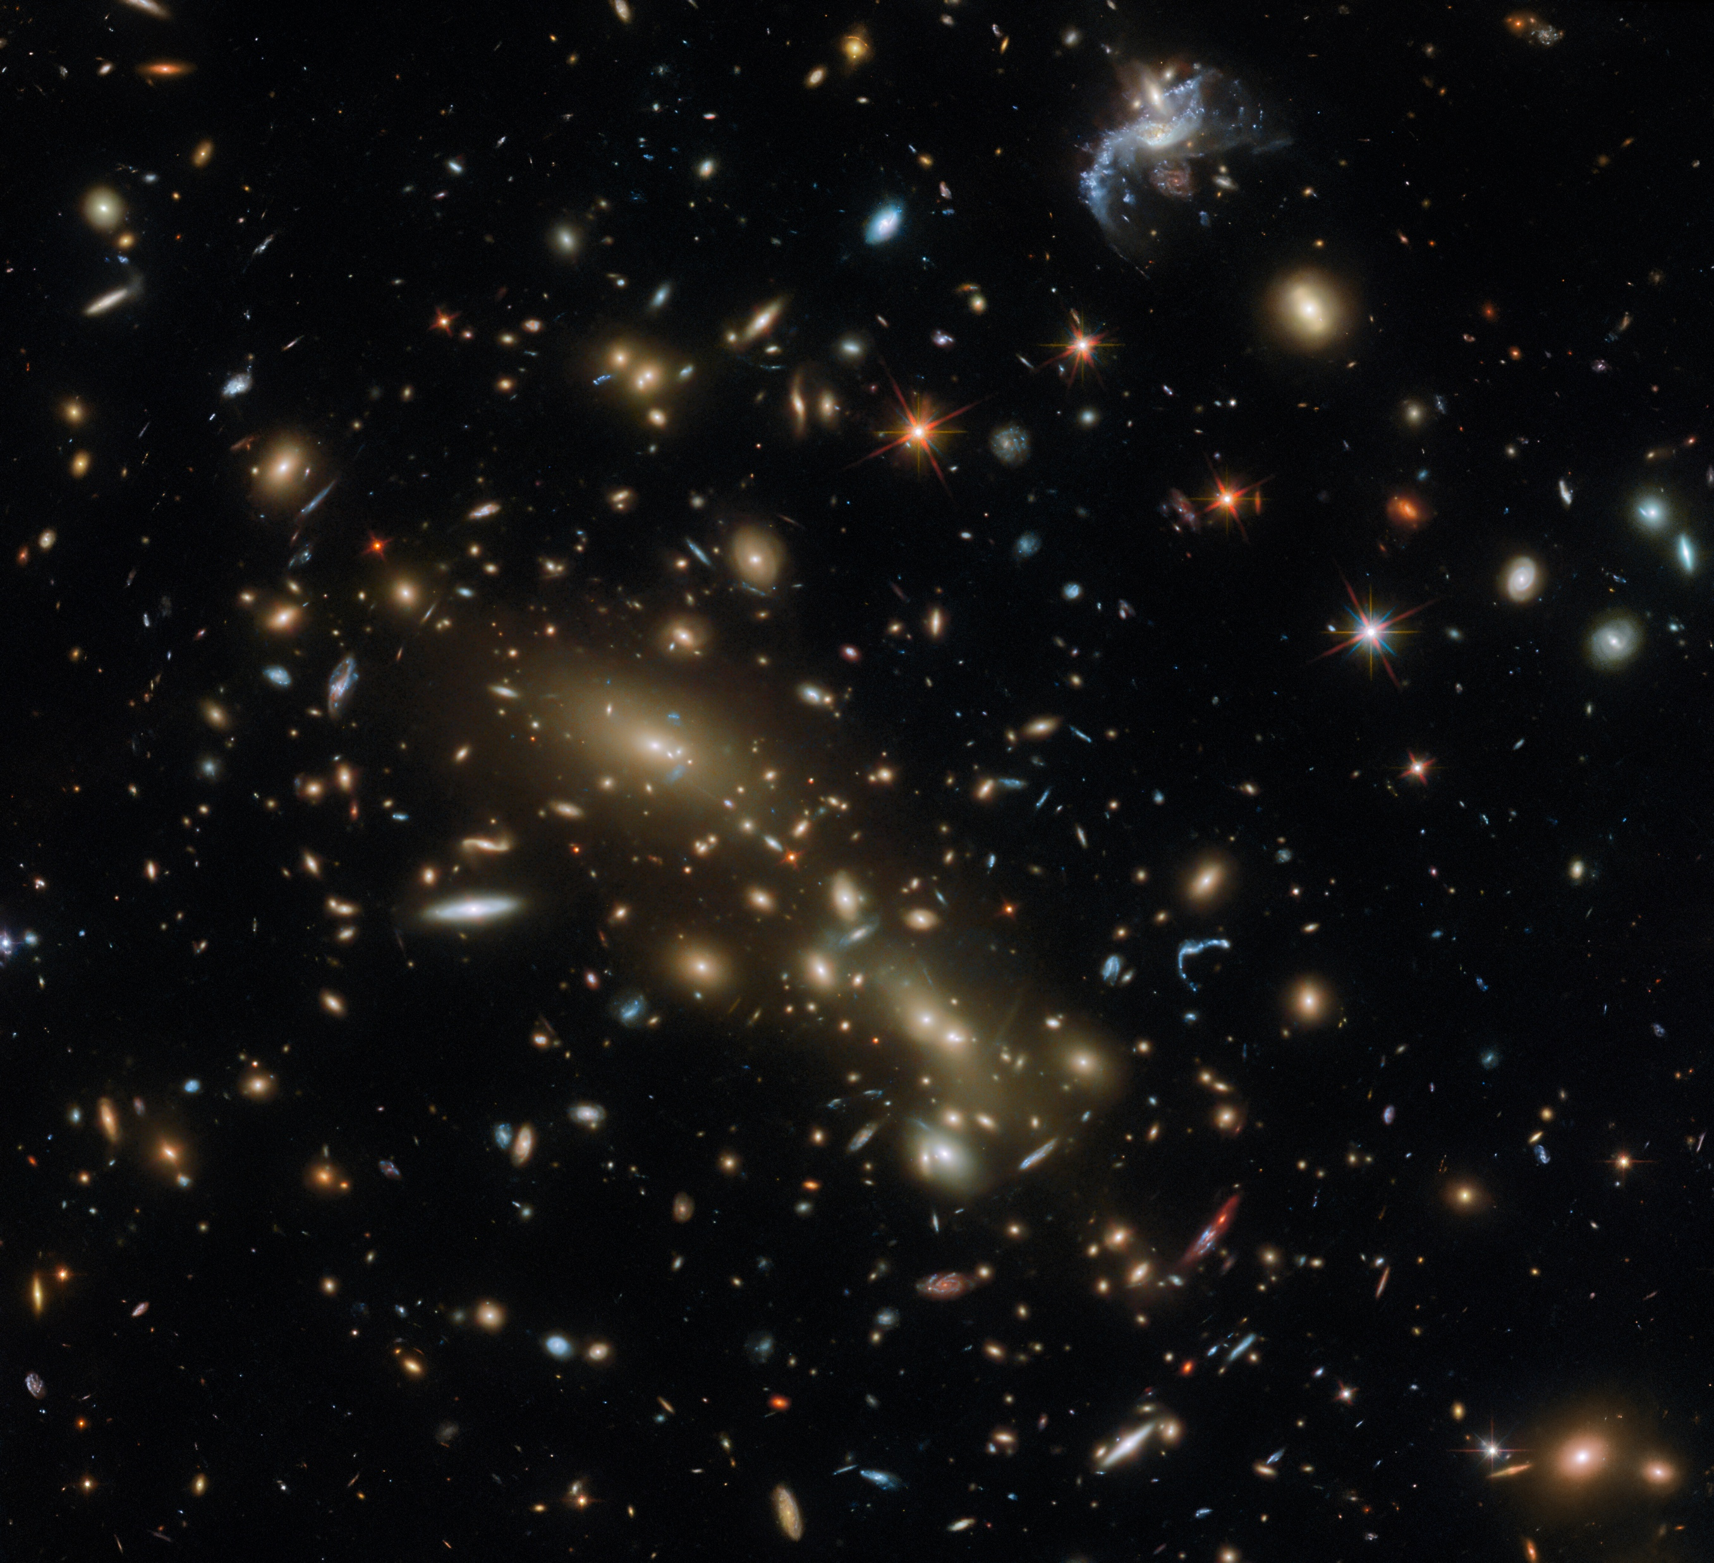
ORIGIN OF GALAXY MORPHOLOGY
In 1923, thanks to Edwin Hubble’s discovery, we realized that ‘nebulae’ were actually entire galaxies beyond the Milky Way.

Slide 3
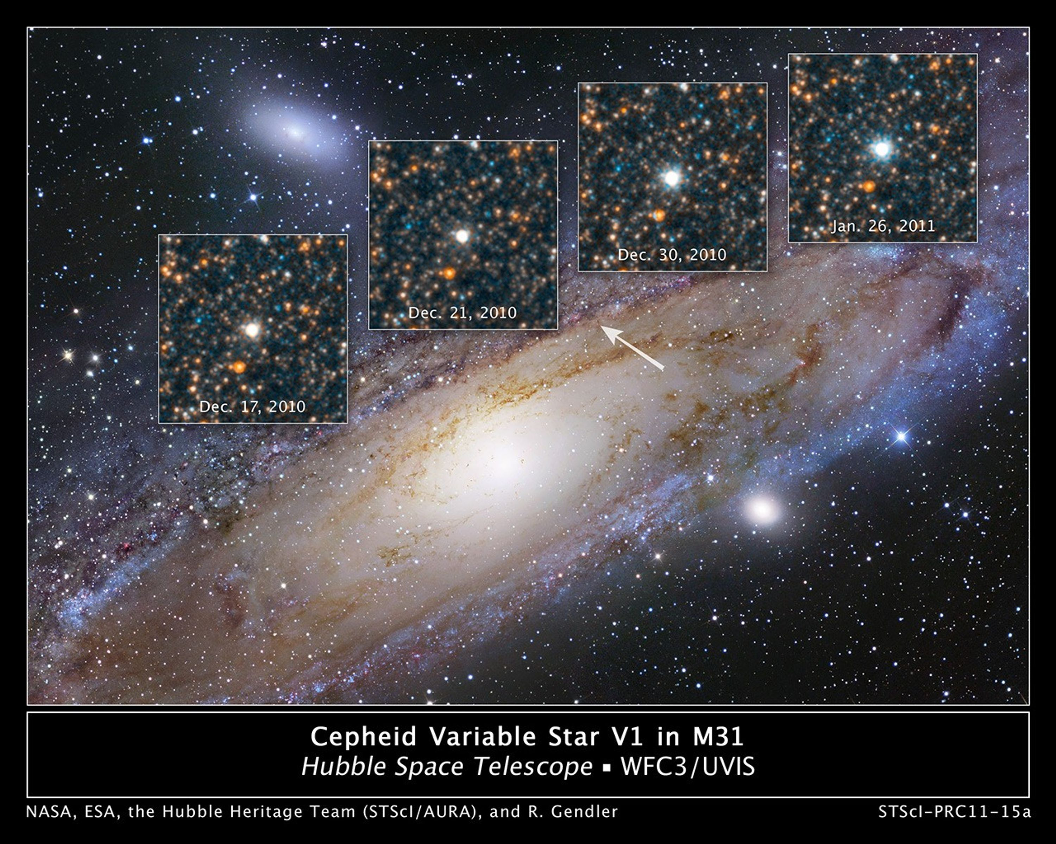
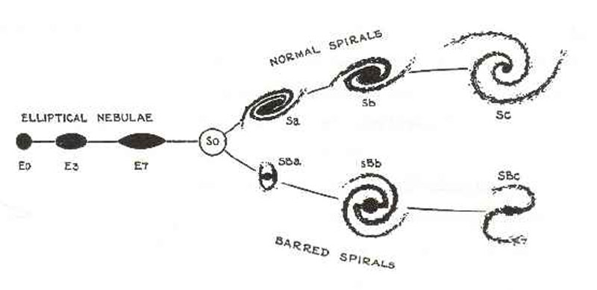
CEPHEID VARIABLES AND THE TUNNING FORK DIAGRAM
3

Slide 4
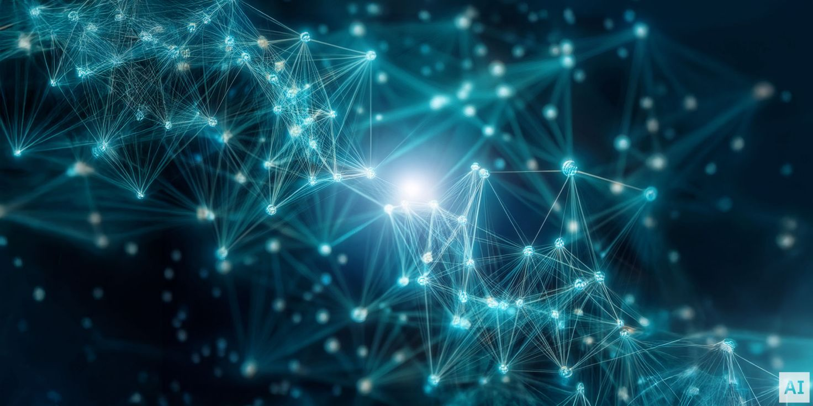
CONVOLUTIONAL NEURAL NETWORKS
In order to improve and automate this classification task, we applied CNNs, a type of machine learning well-suited for image classification because it can take advantage of symmetries in data.

Slide 5
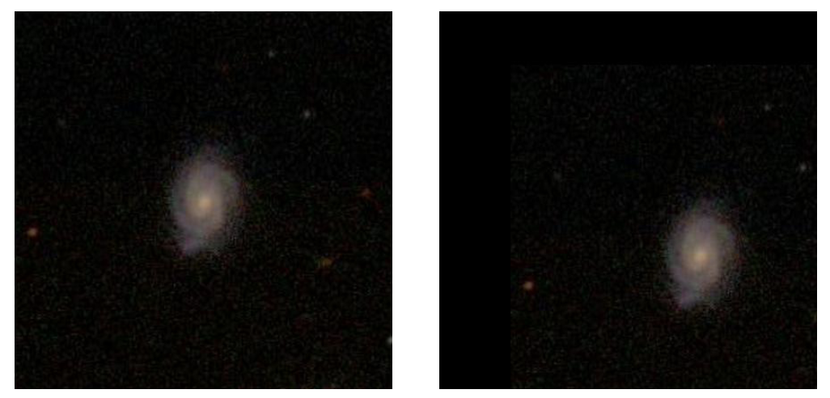
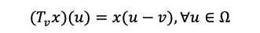
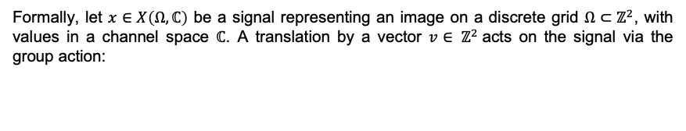
GROUP THEORY FOUNDATIONS
Formally, let $x∈X\left(Ω,ℂ\right)$ be a signal representing an image on a discrete grid $Ω⊂ℤ^{2}$, with values in a channel space $ℂ$. A translation by a vector $v∈ ℤ^{2}$acts on the signal via the group action:
$$(T_{v}x)(u)=x(u−v),∀u∈Ω$$
5

Slide 6

INVARIANCE AND EQUIVARIANCE IN CNNs
G-invariance: A function $f(x)$is invariant if transforming the input under a group $G$ does not change the output. (e.g., $f(ρ(g)x)=f(x))$).
G-equivariance: A function $f(x)$is equivariant if transforming the input results in an output transformed in the same way. (e.g., $f(ρ(g)x)=ρ(g)f(x)$ ).
CNNs are translation-equivariant: shifting the input shifts the output feature maps in the same way, preserving the structure of the translation.
6

Slide 7
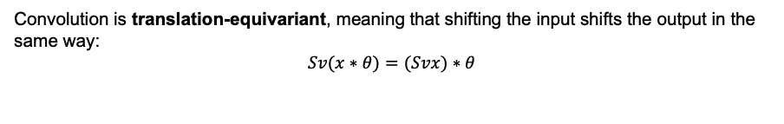
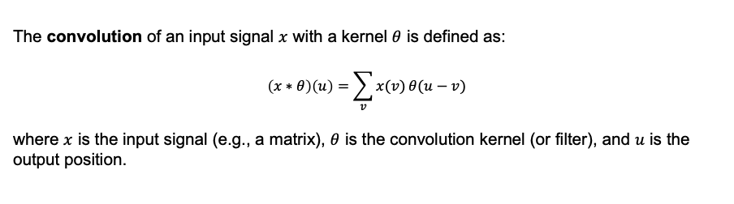
CONVOLUTION
The convolution of an input signal $x$ with a kernel $θ$ is defined as:
$$\left(x∗θ\right)\left(u\right)=\sum_{v}{x(v) θ(u−v)}$$
where $x$ is the input signal (e.g., a matrix), $θ$ is the convolution kernel (or filter), and $u$ is the output position.
Convolution is translation-equivariant, meaning that shifting the input shifts the output in the same way:
$$Sv(x∗θ)=(Svx)∗θ$$
7

Slide 8
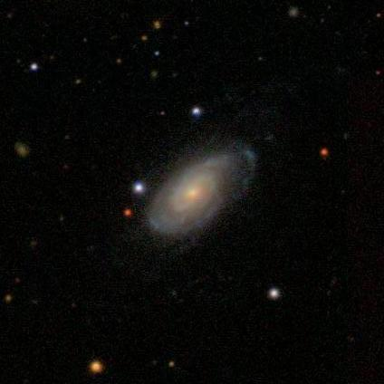
THE CLASSIFICATION JOURNEY
How does a galaxy image make its journey from raw observational data to its final morphological classification?

Slide 9
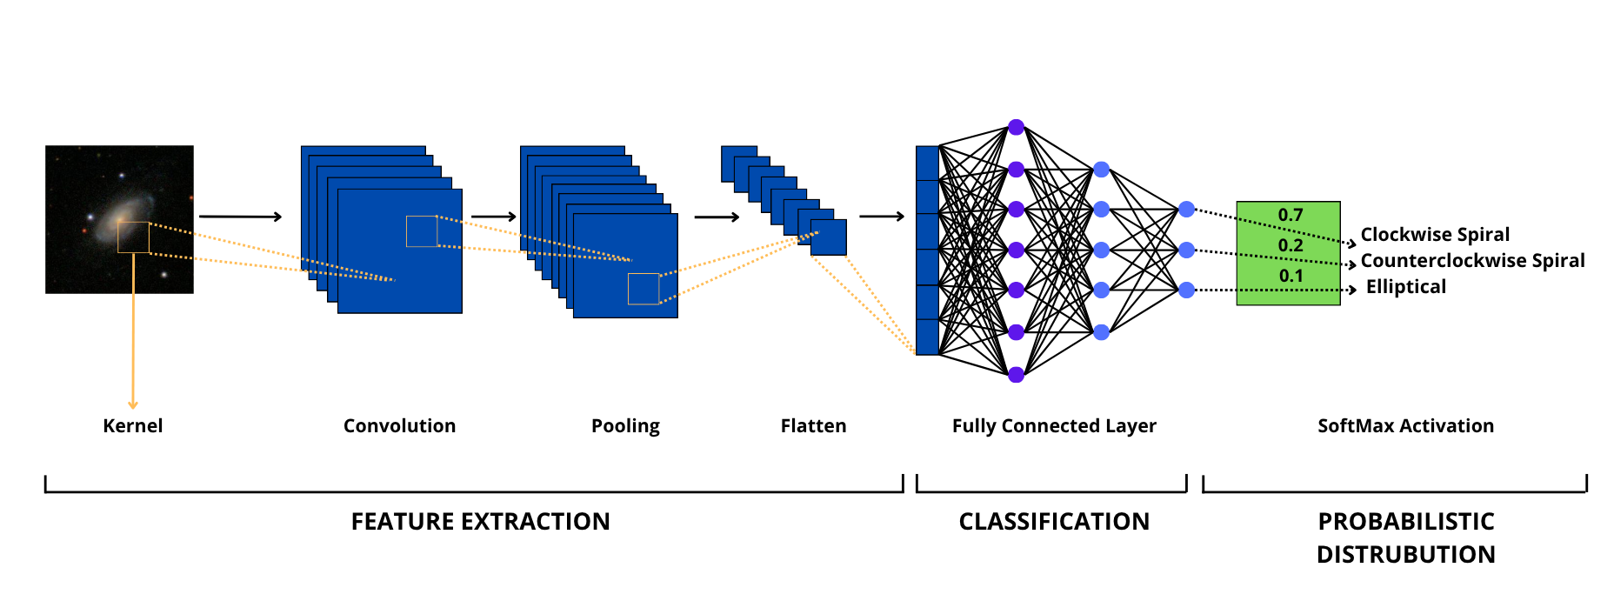
THE CLASSIFICATION PROCESS
9

Slide 10
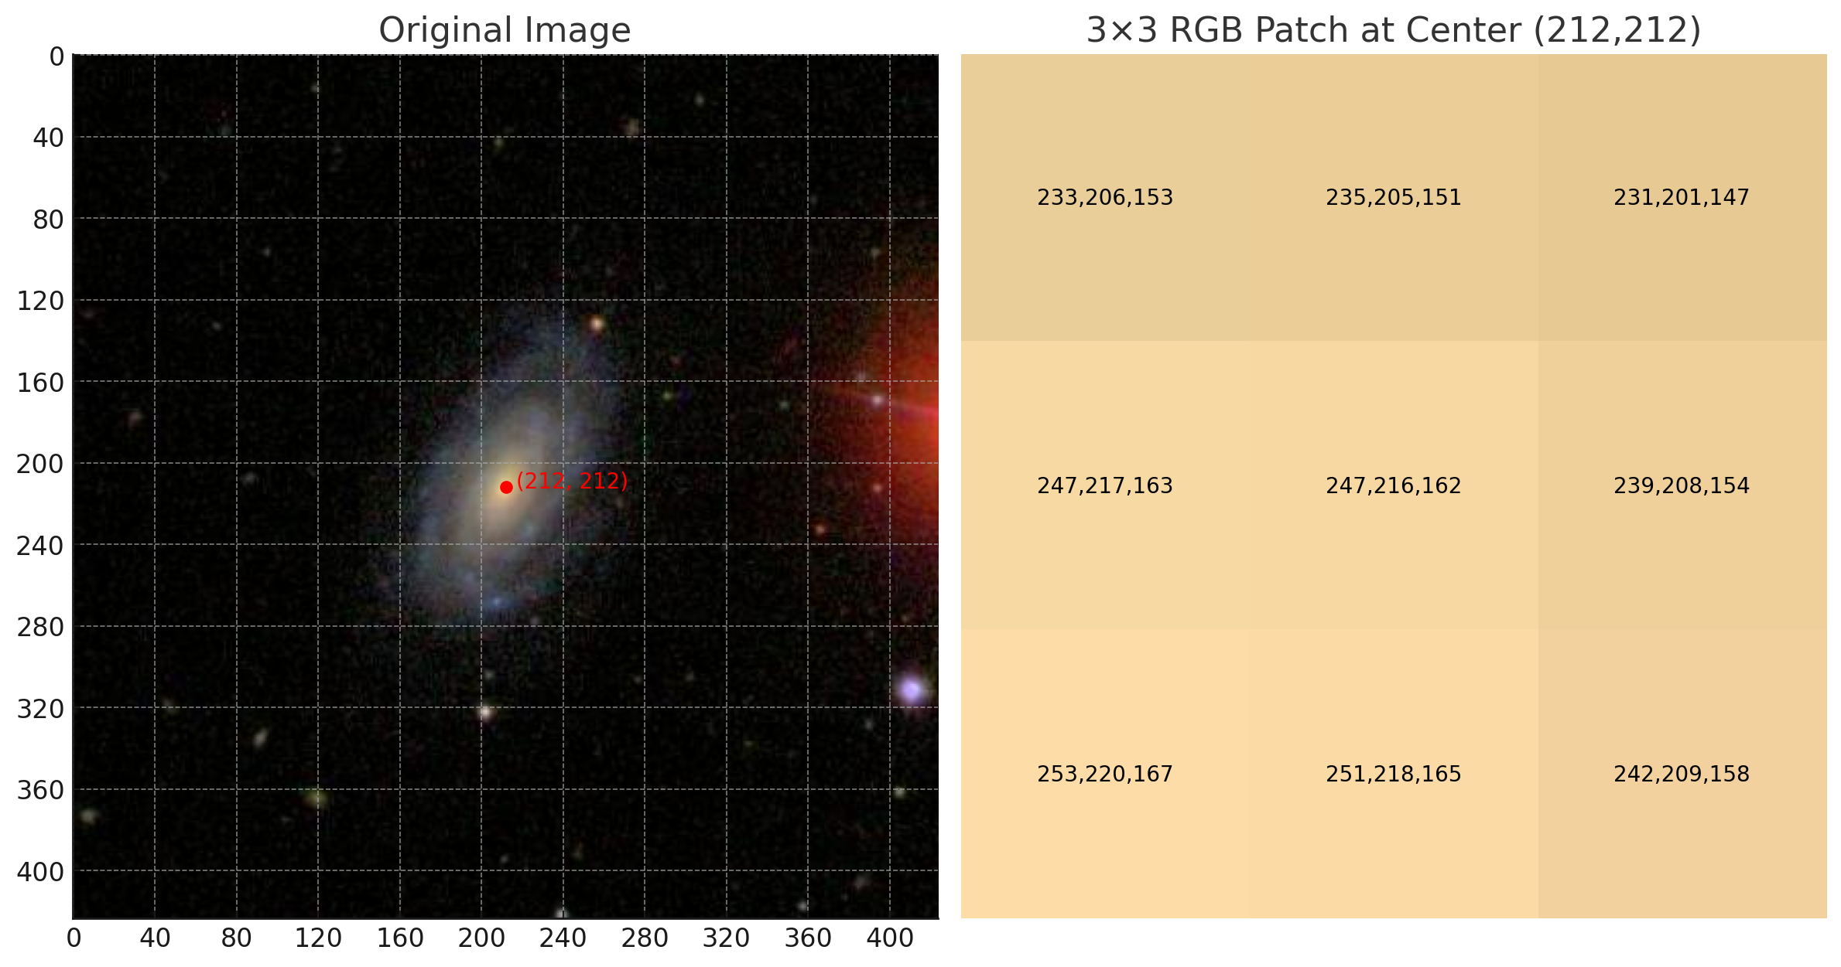
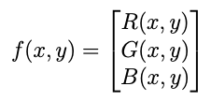
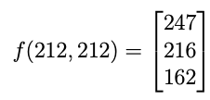
FROM VISUAL TO NUMERICAL
An RGB image is a 3D tensor with shape ($H$, $W$, $3$), where H and $W$ are the height and width of the image, and the 3 channels represent red, green, and blue.
10

Slide 11
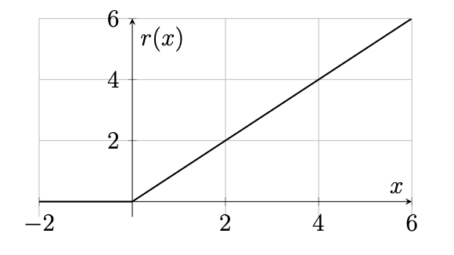
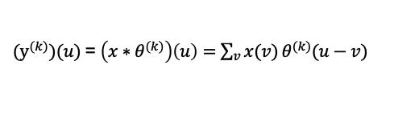
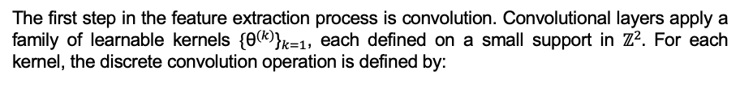
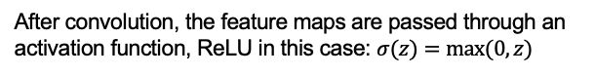
CONVOLUTION + RELU
The first step in the feature extraction process is convolution. Convolutional layers apply a family of learnable kernels ${{\text{\{}\text{θ}}^{(k)}\text{\}}}_{k=1}$, each defined on a small support in $ℤ^{2}.$ For each kernel, the discrete convolution operation is defined by:
$({\text{y}}^{(k)})(u)$= $\left(x∗θ^{(k)}\right)\left(u\right)=\sum_{v}{x(v) θ^{(k)}(u−v)}$
After convolution, the feature maps are passed through an activation function, ReLU in this case: $σ(z)=max⁡(0,z)$
This step allows the network to learn nonlinear relationships in the data:
$z(k)(u)=σ(({\text{y}}^{(k)})(u)$)
11

Slide 12
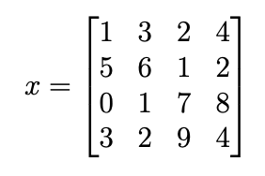
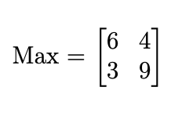
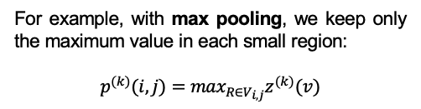
POOLING
Pooling reduces the size of activated feature maps to speed up computation. It lowers spatial resolution while preserving key features and keeping the number of channels unchanged.
For example, with max pooling, we keep only the maximum value in each small region:
$$p^{(k)}(i,j)=\max_{R∈V_{i,j}}z^{(k)}(v)$$
12

Slide 13
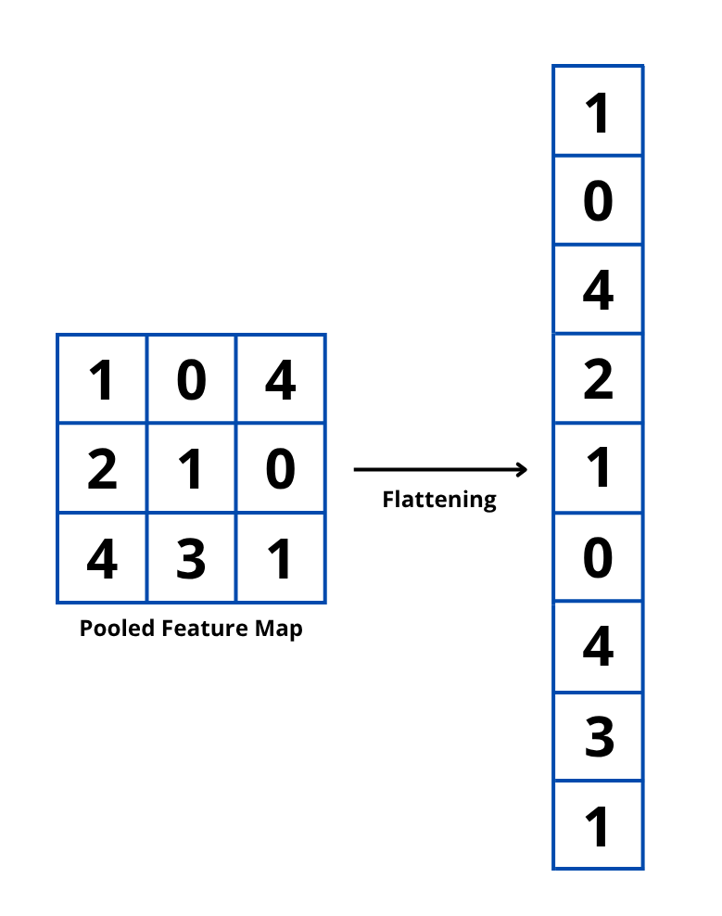
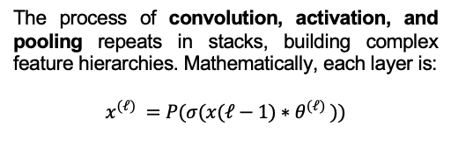
FLATENNING
The process of convolution, activation, and pooling repeats in stacks, building complex feature hierarchies. Mathematically, each layer is:
$$x^{(ℓ)} =P(σ(x(ℓ−1)∗θ^{(ℓ)} ))$$
Finally, to connect to fully connected layers for classification, the feature map is flattened transforming the 3D tensor into a 1D vector so it can be processed by standard classifiers.
13

Slide 14
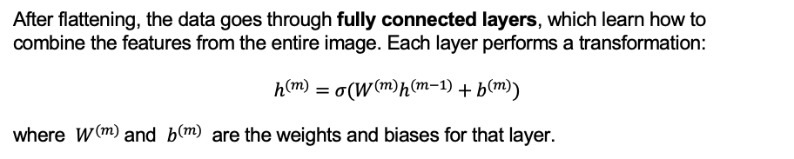
FULLY CONNECTED LAYER
After flattening, the data goes through fully connected layers, which learn how to combine the features from the entire image. Each layer performs a transformation:
$$h^{(m)}=σ(W^{(m)}h^{(m−1)}+b^{(m)})$$
where $W^{(m)}$and $b^{(m)}$ are the weights and biases for that layer.
14

Slide 15
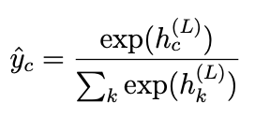
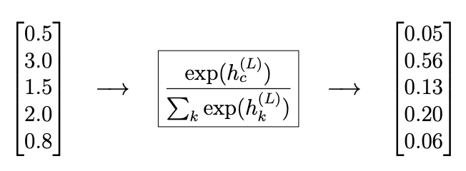
SOFTMAX + ACTIVATION
The last dense layer uses the softmax function to produce probabilities for each class:
Softmax turns outputs into values between 0 and 1 that sum to one perfect for multi-class classification.
15

Slide 16

COMPUTATIONAL RESULTS
Having concluded the mathematical explanation of CNNs, we now turn to the second main goal of this tesis: a program for galaxy morphological classification

Slide 17
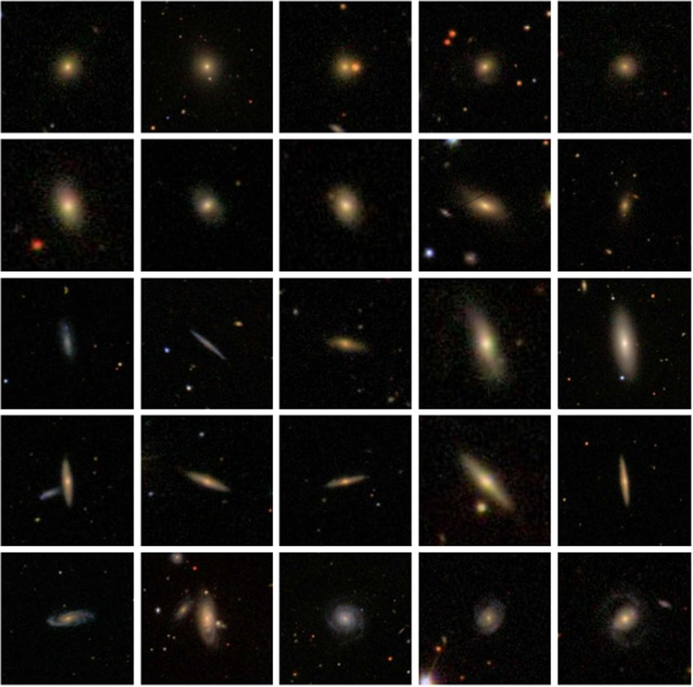
OUR DATASET:
Galaxy Zoo Project
Clockwise Spiral
Anticlockwise Spiral
Disk
Merger
Edge
Elliptical
Cosmological Structure
Uncertain
17

Slide 18
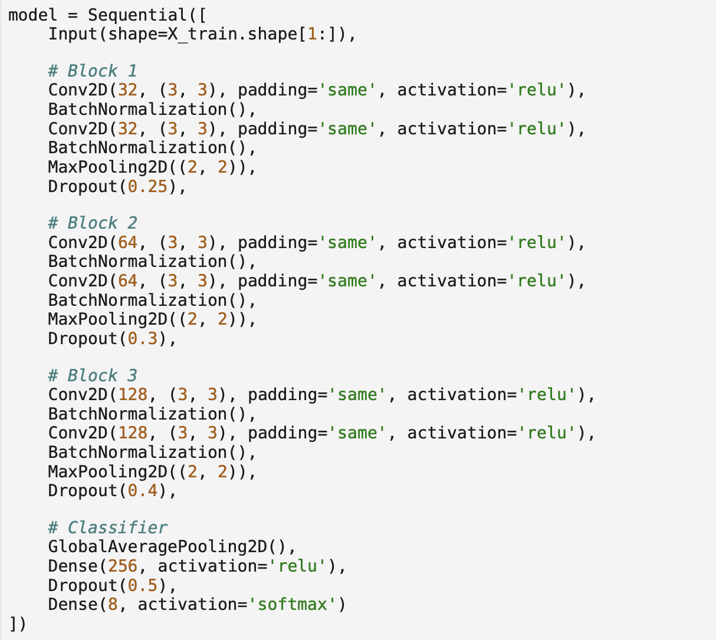
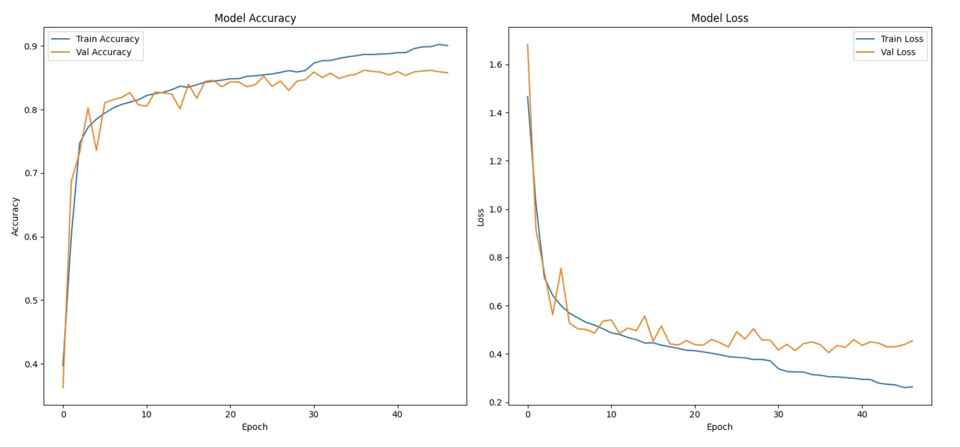
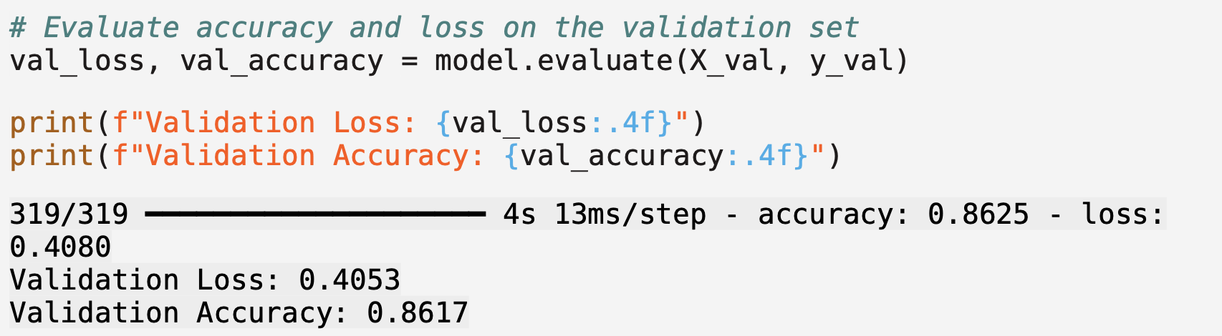
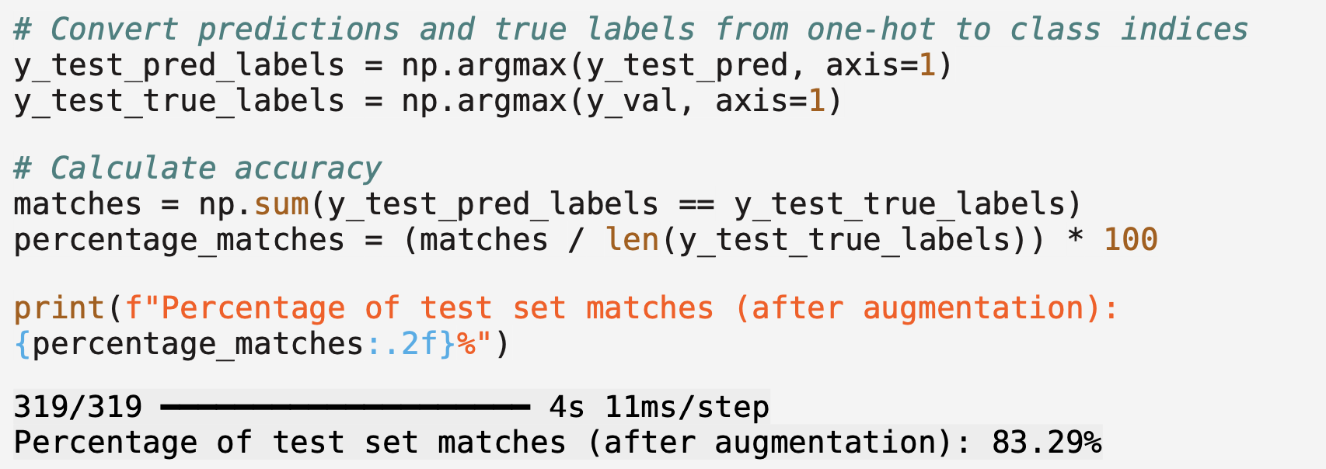
ARCHITECTURE AND RESULTS:
18

Slide 19
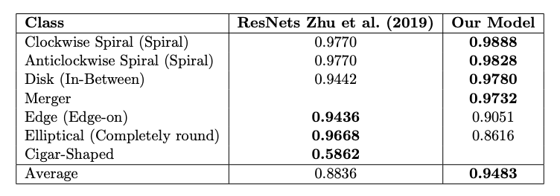
ACCURACY COMPARISON:
19

Slide 20
CONCLUSION
We explored the usefulness of Convolutional Neural Networks for galaxy morphological classification, bridging mathematics, machine learning, and astronomy.
Future improvements could include deeper mathematical analysis, advanced data augmentation and re-labelling.
In summary, this work highlights how math and machine learning can tackle big scientific challenges and deepen our understanding of the universe.

Slide 21
